Slide 1
Exp6
Switch Mode Power Supply and UPS

Slide 2
SMPS
Short for switched-mode power supply,
Switched Mode Power Supply (SMPS) is a power supply unit (PSU) that converts unregulated AC or DC voltage into regulated DC by using switching devices.

Slide 3
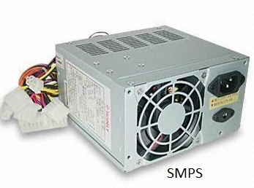

Slide 4
electricity which is supplied in our house is an alternating current (AC). But computer requires stable and efficient power supply.
SMPS is used to provide power to different components in a computer. Which turns AC into constant energy. Which is called direct current DC.
SMPS is an electronic circuit. These electronic devices include a combination of capacitors, inductors and semi-conductor devices such as diodes and MOSFETs.

Slide 5
SMPS in computer – what is SMPS in computer
In a computer or laptop, SMPS is part of a hardware.
Which is fitted inside the case.
If we open the computer, a tin box will appear in its backside.
The work of SMPS is to provide power to use different parts (Ram and motherboard) in the computer.

Slide 6
Major functions of SMPS
1. To start electronic devices, it works by supplying power until it is loaded from source.
2. It converts a voltage AC power to low voltage DC power.
3. Regulating electric power in input voltage provides reliable output.
4. Different components in the computer require electric power. SMPS provides power to every part according to its requirement.

Slide 7
Advantages of SMPS
1. smps has low weight.
2. smps has a higher output range.
3. This emits very little heat. Depends on its capacity.
4. It is light and small.

Slide 8
Disadvantages of SMPS
1. The function of smps is very complex.
2. It has an output voltage.
3. Its work is difficult to understand.
4. It uses High Frequency Electrical Noise.
5. It works on the Step Down Regulator.

Slide 9
Key parts of computer SMPS
Some key parts inside computer like: –
1. Heat sink : – It absorbs heat when the transistor is hot.
2. Transistor : – This switches the power.
3. Choke coil : – which gets DC current. It works to smooth it.
4. Rectifier : – It converts AC power to DC. Which is called diode.
5. Transformer : – It controls the incoming voltage by up and down
6. Capacitor : – It filters unregulated DC from rectifier. And changes it to smooth DC.

Slide 10
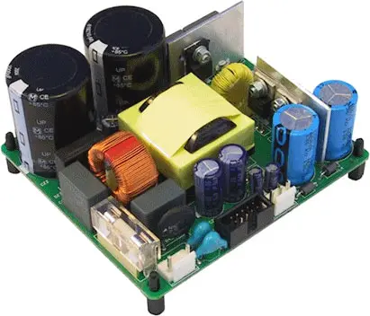
An Image Of Switched Mode Power Supply

Slide 11
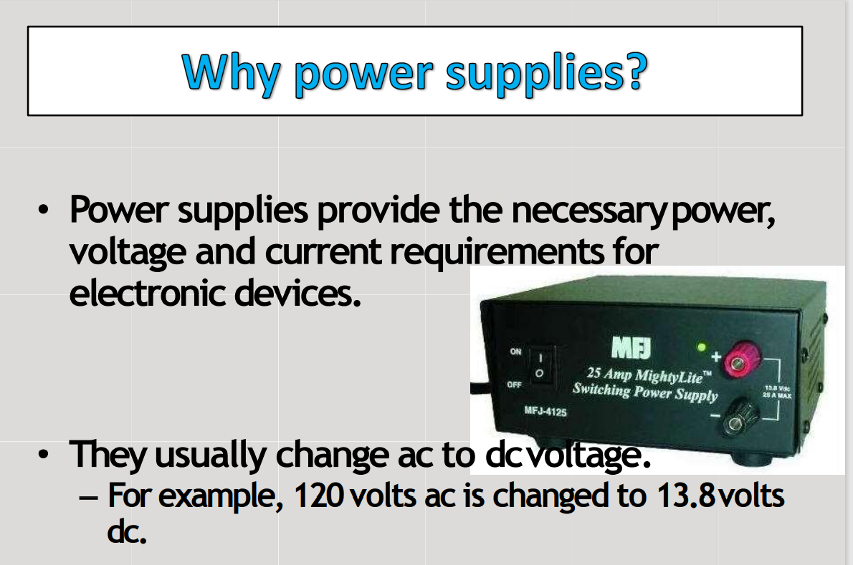

Slide 12
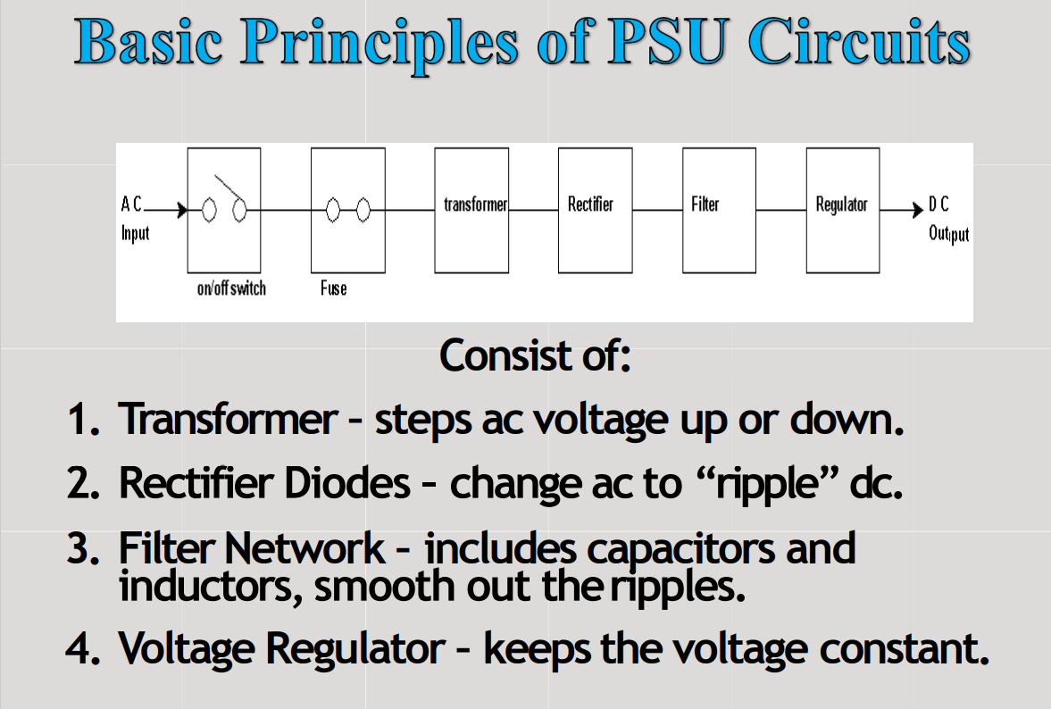

Slide 13
An SMPS’s functionality is complex but we can break it down into five stages:
1. In the first stage, the incoming AC power runs through a rectifier and undergoes filtration to produce DC
2. The SMPS works at high frequencies, so a high-frequency switch processes the DC signal, which creates a high-frequency pulsating DC signal
3. The power transformer steps down the high-voltage DC signal to a DC signal of the appropriate level
4. The stepped-down DC signal is rectified and filtered to a achieve a steady, constant DV output
5. The control circuitry monitors the output voltage and adjusts the high-frequency switch on-the-fly to ensure a continuous output stream of the desired voltage

Slide 14
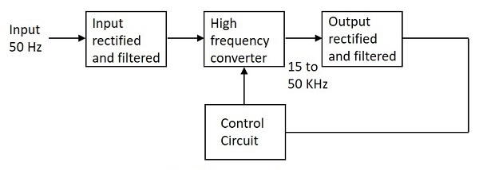
Functional Diagram of SMPS

Slide 15
Applications
There are many applications of SMPS.
They are used in the motherboard of computers,
mobile phone chargers,
HVDC measurements(High Voltage Direct Current),
battery chargers,
central power distribution,
motor vehicles,
consumer electronics,
laptops,
security systems,
space stations, etc.

Slide 16
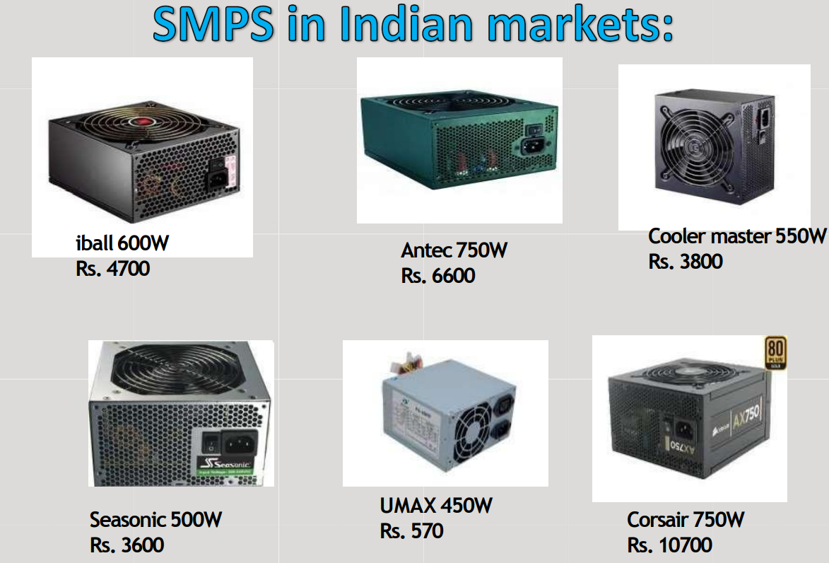

Slide 17
UPS

Slide 18
An uninterruptible power supply (UPS) is a device that allows a computer to keep running for at least a short time when the primary power source is lost.
UPS devices also provide protection from power surges.

Slide 19
A UPS contains a battery that "kicks in" when the device senses a loss of power from the primary source.
If an end user is working on the computer when the UPS notifies of the power loss, they have time to save any data they are working on and exit before the secondary power source (the battery) runs out.
When all power runs out, any data in your computer's random access memory (RAM) is erased.
When power surges occur, a UPS intercepts the surge so that it does not damage the computer.

Slide 20
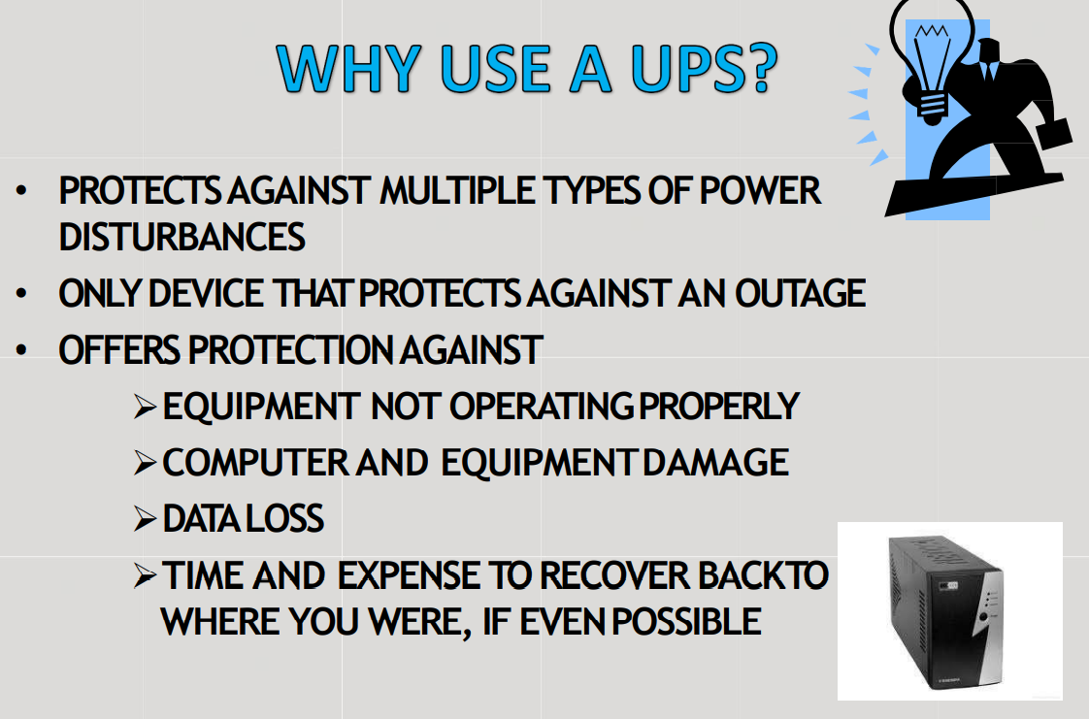

Slide 21
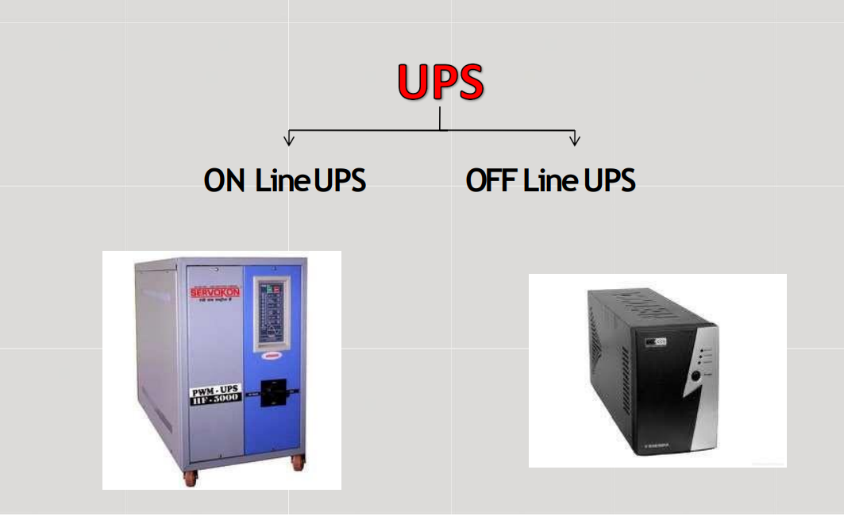

Slide 22
There are versions of the UPS:
standby UPS
online UPS
With a standby UPS (offline UPS), the UPS switches to battery power when the power problem occurs.
With an online UPS, the UPS always provides power from the battery, and while they offer better protection, they are more expensive.
For most home users and small businesses, a standby UPS will meet all their needs.

Slide 23
Major Roles of a UPS
When there is any failure in main power source, the UPS will supply the power for a short time. This is the prime role of UPS.
In addition to that, it can also able to correct some general power problems related to utility services in varying degrees

Slide 24
How would having a UPS help a computer?
Having your computer connected to a UPS protects it from electrical surges and outages.
When computers shut down improperly, such as when a power outage happens, it can damage the computer's internal parts and cause lost data.
Having a UPS helps prevent the computer from being improperly shut down and helps protect the computer and its data.

Slide 25
Applications and Role
When power failures such as power outages occur, computer devices such as servers and workstations may break down, leading to various problems such as the loss of important data and program malfunction.
Moreover, even a momentary voltage drop on factory production lines, can result in system stoppages, defective products, and in the worst-case scenario, damage to equipment.

Slide 26
These issues can be avoided by installing UPS in computers, network systems, production lines, and the like and it is also possible to operate systems with stability and efficiency using the various functions of the UPS.

Slide 27
Advantages and disadvantages of UPS
Advantages to using uninterruptable power supplies include:
No delay between switching from the primary power source to the UPS.
Can better support critical instruments compared to generators.
Consumers can choose the type and size of UPS, depending on the amount of power they need to supply to a device.
UPSs are silent.
Maintenance of UPS systems is cheaper compared to generators.

Slide 28
Disadvantages to using uninterruptable power supplies include:
The inability to run heavy appliances- because UPSs are run off of batteries.
If substandard batteries are used, users may end up replacing the batteries often.
UPSs may need professional installations.

Slide 29
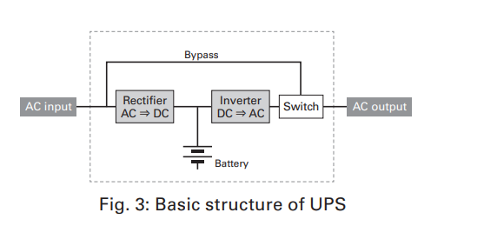

Slide 30
Basic structure
UPS consists of the following circuits and the battery. In the event of a power outage or failure occurring in the AC input, the UPS continues supplying power from the batteries to the AC output.
(1) Rectifier: Circuit which converts AC power to DC power
(2) Inverter: Circuit which converts DC power to AC power
(3) Bypass: Circuit which directly outputs AC power
(4) Switch: Circuit which switches between inverter output
and bypass output

